Slide 1
Software Testing Techniques

Slide 2
Software Testing
Testing is the process of exercising a
program with the specific intent of finding
errors prior to delivery to the end user.
Testing is the one step in the software process that could be viewed psychologically as destructive rather than constructive

Slide 3

What Testing Shows
errors
requirements conformance
performance
an indication
of quality

Slide 4


Who Tests the Software?
developer
independent tester
Understands the system
Must learn about the system,
but, will test "gently"
but, will attempt to break it
and, is driven by "delivery"
and, is driven by “quality”

Slide 5
Testing Objectives
Testing is a process of executing a program with an intent of finding an error
A good test case is the one that has a higher probability of finding an as-yet-undiscovered errors
A successful test is one that uncovers an as-yet-undiscovered error
Objective : To design tests that systematically uncover
different classes of errors and to do so in minimum
amount of time and effort

Slide 6
Testing Principles
All tests should be traceable to customer requirements
Tests should be planned long before testing begins
The Pareto principle applies to software testing
Testing should begin “in the small” and progress toward testing “in the large”
Exhaustive Testing is not possible
To be most effective, testing should be conducted by an independent third party

Slide 7
Testability
Software Testability is simple how easily [a computer program] can be tested
Operability — it operates cleanly
Observability — the results of each test case are readily observed
Controllability — the degree to which testing can be automated and optimized
Decomposability — testing can be targeted
Simplicity — reduce complex architecture and logic to simplify tests
Stability — few changes are requested during testing
Understandability — of the design

Slide 8

Attributes of a Good Test
A good test has a high probability of finding an error
A good test is not redundant
A good test should be “best of breed”
A good test should be neither too simple nor too complex

Slide 9
Exhaustive Testing
loop < 20 X
14
There are 10 possible paths! If we execute one
test per millisecond, it would take 3,170 years to
test this program!!

Slide 10
Selective Testing
Selected path
loop < 20 X

Slide 11
Test-Case:
A set of inputs, execution preconditions, and expected outcomes developed for a particular objective, such as to exercise a particular program path or to verify compliance with a specific requirement.
Test case design technique: A method used to derive or select test cases.

Slide 12
Test Case Design
"Bugs lurk in corners
and congregate at
boundaries ..."
Boris Beizer
OBJECTIVE
to uncover errors
CRITERIA
in a complete manner
CONSTRAINT
with a minimum of effort and time

Slide 13
… cont’d
There are two ways of testing a product
  Black-Box testing
    tests are conducted at the software interface
    Checks whether inputs, outputs and functions are properly working
    It pays little regard to the internal logical structure
  White-Box testing
    Closely examines the procedural details
    Logical paths are thoroughly tested

Slide 14
White-Box Testing

Slide 15

White-Box Testing (or Glass Box Testing)
... our goal is to ensure that all
statements and conditions have
been executed at least once ...

Slide 16
Guarantee that all independent paths within a module have been exercised at least once
Exercise all logical decisions on their true and false sides
Execute all loops at their boundaries and within their operational bounds
Exercise internal data structures to ensure their validity

Slide 17
Why Cover?
logic errors and incorrect assumptions
are inversely proportional to a path's
execution probability
we often
believe
that a path is not
likely to be executed; in fact, reality is
often counter intuitive
typographical errors are random; it's
likely that untested paths will contain
some

Slide 18
Basis Path Testing
  White box testing technique
  Derive a logical complexity measure
  Define a basis set of execution paths
  Thus, test cases derived to exercise the basis set are guaranteed to execute every statement in the program at least once

Slide 19
Basis Path Testing
Flow Graph Notation
Cyclomatic Complexity Analysis
Graph Matrices

Slide 20
Flow Graph Notation
Node one / more procedural statements
Edge / Link Indicates flow of control
Areas bounded by edges and nodes are called Regions
Area outside the graph is also a region
A Predicate Node is a node that contains a condition

Slide 21

Flow Graph Fundamentals
The flow graph is somewhat similar to a flowchart
There are nodes (vertices) for
  Assignment and procedure call statements
  Predicates (conditional expressions)
    If the predicate involves an “and” or an “or”, multiple nodes will be needed
  All “End If”, “End While” and “End Case” clauses
A linear sequence of nodes can be combined into one node

Slide 22
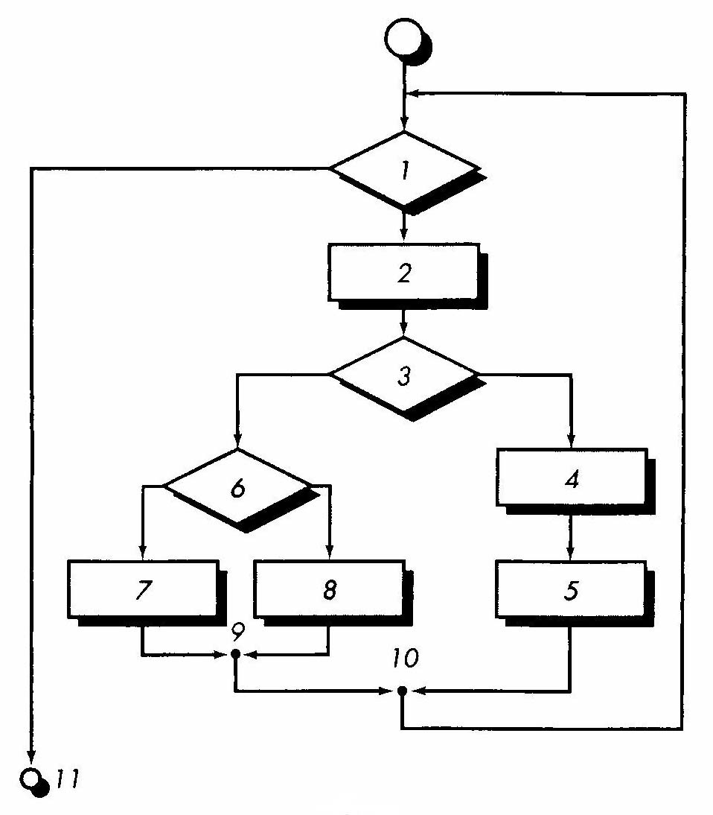
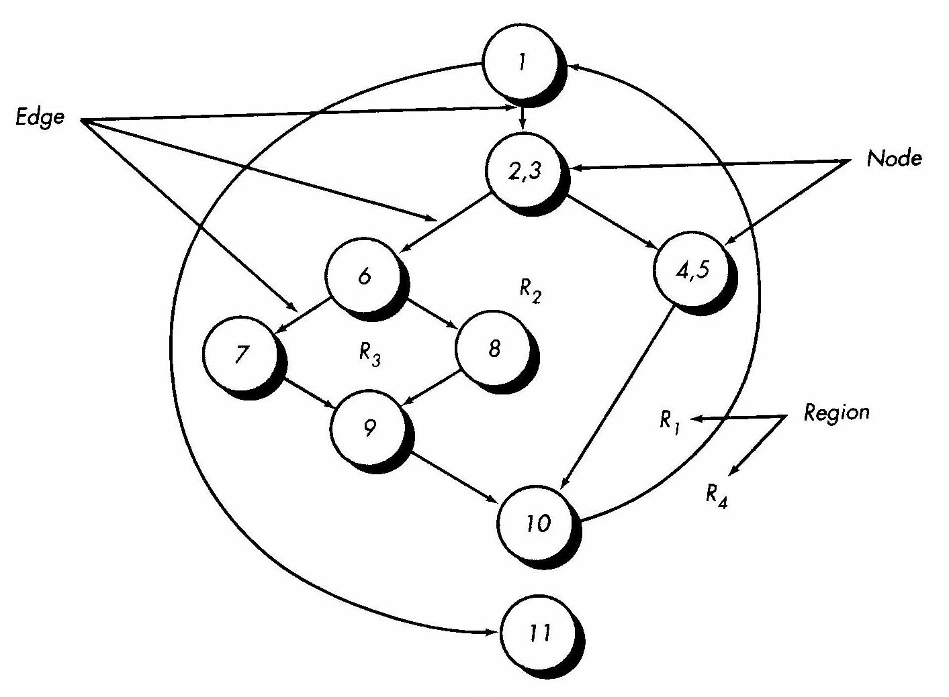
Flow chart
=
Flow graph
Picture Source: Roger Pressman, Software Engineering, 5th Edition

Slide 23
Cyclomatic Complexity
A Software metric that provides a quantitative measure of the logical complexity of the program.
It defines the number of independent paths in the basis set i.e. an upper bound on the number of tests that need to be made.
Independent path : Any path through the program that introduces at least one new set of processing statements or condition variables.

Slide 24
How many paths to look for?
Formulae for measuring Cyclomatic Complexity
  V(G) = R
  V(G) = E - N + 2
  V(G) = P + 1
  Where,
    R = Number of regions
    E = Number of edges
    N = Number of nodes
    P = Predicate nodes

Slide 25
Steps in Testing
1. Draw the flow graph
2. Calculate the cyclomatic complexity, V(G).
3. Determine a basis set.
4. Prepare test cases that will force the execution of each path in the basis set.

Slide 26
Example program
Flow chart
=
Flow graph
Picture Source: Roger Pressman, Software Engineering, 5th Edition

Slide 27
Complexity of example program
E = 11
N = 9
V(G) = 11 – 9 + 2 = 4
P = 3
V(G) = 3 + 1 = 4
R = 4
V(G) = 4
V(G) is,…… 4
Notes:
SH:
Note that 4,5 collapses 2 flow sequences into a single bubble/flow graph node.
P = Predicate node, contains a condition. A predicate node has two or more edges emanating from it. (1,2-3,6)

Slide 28
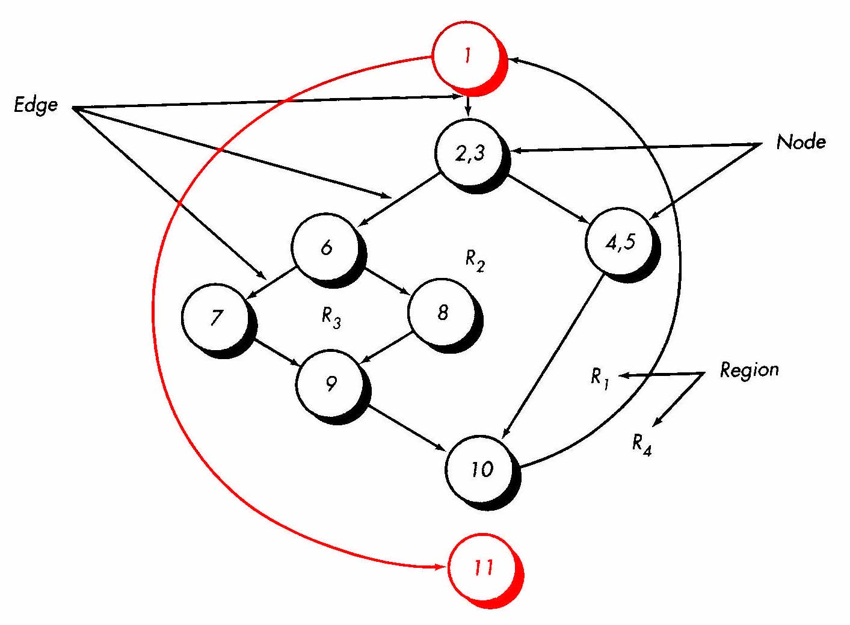
Let’s look at the paths
path 1: 1-11
Notes:
SH:
(Why is this path necessary? Why couldn’t this be picked up as part of the next path, decreasing the number of paths required for a basis set by one?)
CK:
Good question and one that I had last year. This was the example in Pressman, and I don’t know if it’s broken. I can only assume that the approach here is to start with the simplest paths from start to finish, even if they turn out to be redundant. Another evidence that it’s necessary is that if you skip it, you get coverage in just three paths, whereas the V(G) is 4 using the other approaches for deriving it. SW? Any feedback?!

Slide 29
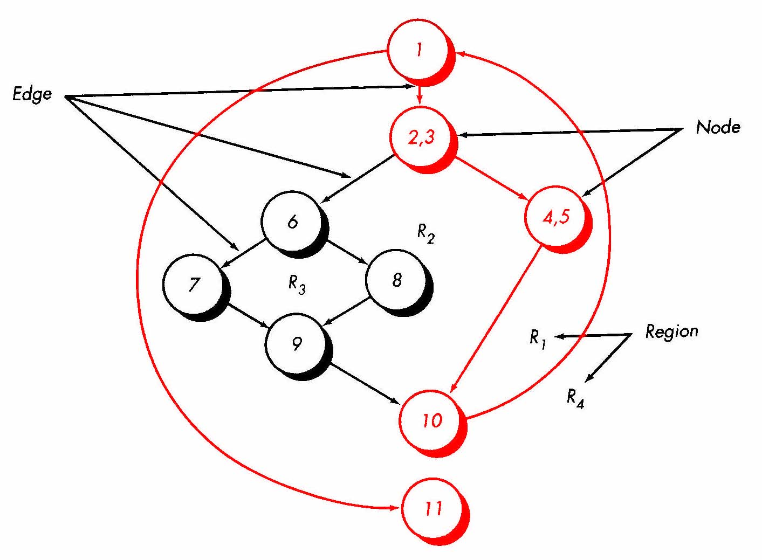
Let’s look at the paths
path 1: 1-11
path 2: 1-2-3-4-5-10-1-11

Slide 30
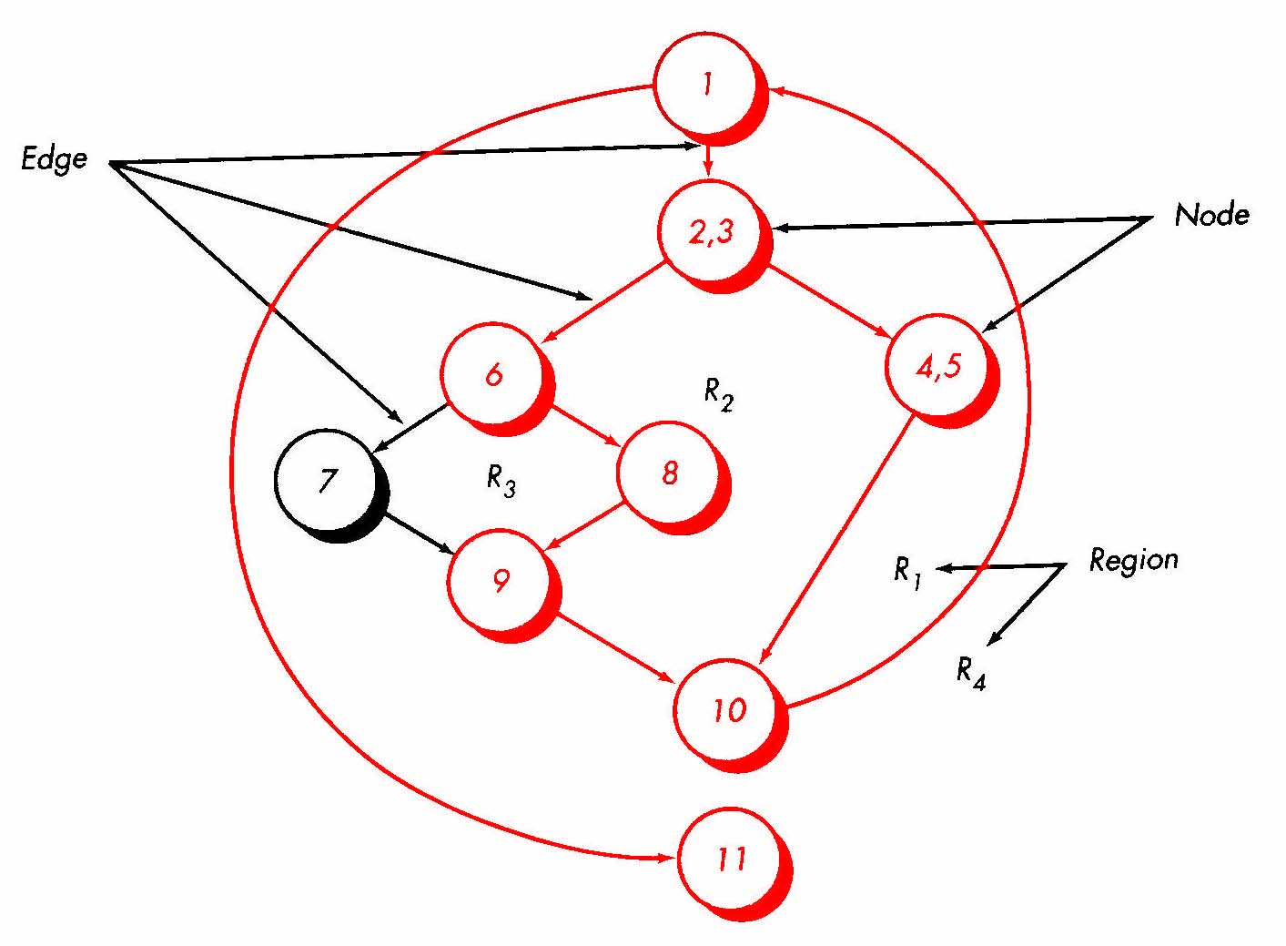
Let’s look at the paths
path 1: 1-11
path 2: 1-2-3-4-5-10-1-11
path 3: 1-2-3-6-8-9-10-1-11

Slide 31
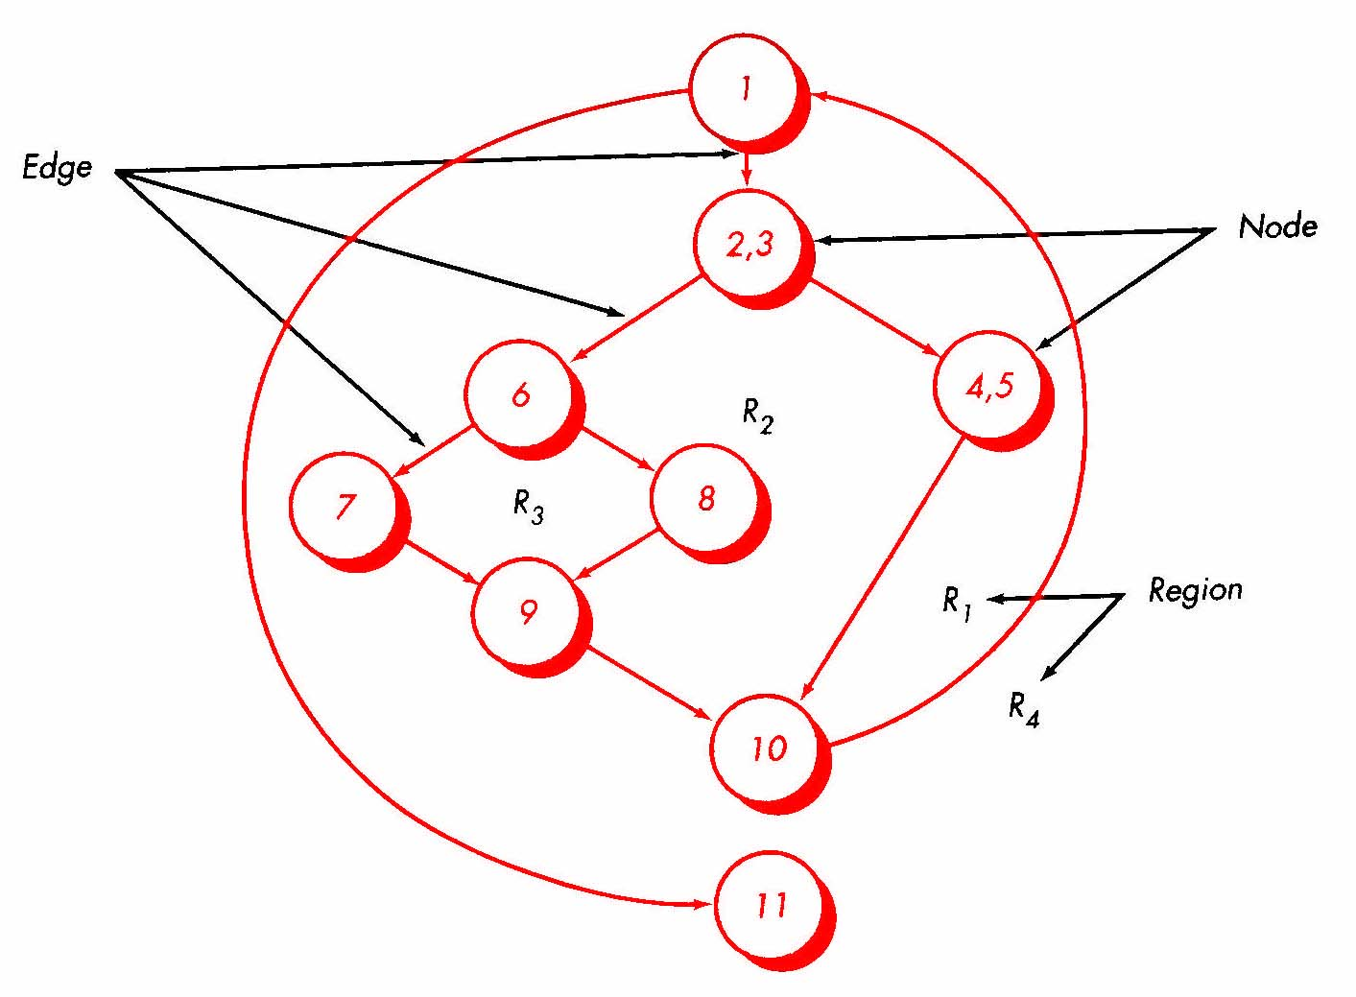
Let’s look at the paths
path 1: 1-11
path 2: 1-2-3-4-5-10-1-11
path 3: 1-2-3-6-8-9-10-1-11
path 4: 1-2-3-6-7-9-10-1-11

Slide 32
Great, so now what?
So now you set about to design test cases that cause the basis set of paths to execute
To summarize:
  Using the code, draw the flow graph
  Determine V(G) of the flow graph
  Determine a basis set of independent paths
  Prepare a set of test cases that will force all paths in the basis set

Slide 33
Example
  Draw the flow graph, calculate the cyclomatic complexity, list the basis paths and prepare a test case for one path using the following C++ code fragment:
    while(value[i] != -999.0 && totinputs < 100)
    { totinputs++;
    if(value[i] >= min && value[i] <= max)
    { totvalid++;
    sum = sum + value[i];
    } // End if
    i++;
    }// End while

Slide 34
1
2
  while(value[i] != -999.0 && totinputs < 100)
  { totinputs++;
  if(value[i] >= min && value[i] <= max)
  { totvalid++;
  sum = sum + value[i];
  }//End if
  i++;
  }//end while
3
4
5
6
7
1
3
6
7
2
4
5

Slide 35
Cyclomatic Complexity:
  V(G) = number of enclosed areas + 1 = 5
  V(G) = number of simple predicates + 1 = 5
  V(G) = edges - nodes + 2 = 10 - 7 + 2 = 5
1
3
6
7
2
4
5

Slide 36
1-7 (value[i] = -999.0)
1-2-7 (value[i] = 0, totinputs = 100)
1-2-3-6-1-7
1-2-3-4-6-1-7
1-2-3-4-5-6-1-7
1
3
6
7
2
4
5

Slide 37
Cyclomatic Complexity
A number of industry studies have indicated
that the higher V(G), the higher the probability
or errors.
modules
V(G)
modules in this range are
more error prone

Slide 38
Graph Matrices
A graph matrix is a square matrix, whose
  size (i.e. No. of rows and columns) = No. of Nodes in the flow graph
  Each row and column corresponds to an identified node
  Matrix entries correspond to connections (an edge) between nodes
  A link weight is added to each matrix entry

Slide 39
Graph Matrices
Assist in basis path testing
1
2
3
4
5
1
1
1
a
2
e
3
b
3
1
1
d
5
4
f
4
1
1
c
g
2
5
1
1
Flow graph
Connection Matrix

Slide 40
Black-Box Testing

Slide 41
Black-box Testing
Focuses on the functional requirements of the software
It is a complementary approach of White-box techniques and uncover a different class of errors
It is applied during later stages of testing

Slide 42
Black-Box Testing
requirements
output
input
events

Slide 43
Black-Box
Finds Errors In:
Incorrect or missing functions
Interface errors
Data structures or external data base access
Performance errors
Initialization and termination errors

Slide 44
Black-Box Testing Methods
Graph-Based Testing
Equivalence Partitioning
Boundary Value Analysis
Comparison Testing

Slide 45
Equivalence Partitioning Method
Divides the input domain of a program into classes of data from which test cases can be derived.
Test case design is based on an evaluation of equivalence classes for an input condition.
Equivalence class represents a set of valid or invalid states for input conditions.

Slide 46
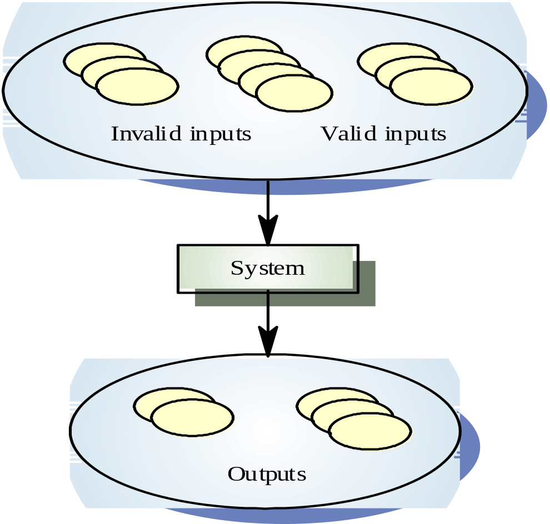
Black-box Testing — Equivalence Partitioning

Slide 47
Input Condition & Equivalence Class
For range, one valid and two invalid equivalence classes are defined
For Specific value, one valid and two invalid equivalence classes are defined
For member of a set, one valid and one invalid equivalence class are defined
For Boolean, one valid and one invalid equivalence class are defined.

Slide 48
Black-box Testing — Equivalence Partitioning
Partition system inputs and outputs into equivalence sets based on specifications
One member of an equivalence set is as good a test case as any other
Guidelines for derivation of equivalence sets
  If a range v1 ... v2, then <v1, v1 ... v2, >v2
  If a value v, then <v, v, >v
  If a set S={ a, b, ..., x }, then S, any value not in S
  If Boolean b, then b=true, b=false
Example - a program is required to handle any integer between 1 and 25, so three equivalence sets, <1, 1 ... 25, >25

Slide 49
Boundary Value Analysis Method
Create test cases that exercise bounding values(The edges of the class)
Complements equivalence class testing
Derives test cases from the input and output domain as well

Slide 50
Guidelines For Boundary Value
Range A to B, Test case for values A and B and just above and below A and B.
Set of values, Test cases for the min and max values and just above and below.
The above applies to output conditions.
Internals programs data structures boundary,test cases for this boundaries.

Slide 51
Black-box Testing — Boundary Value Analysis
Faults frequently exist at and on either side of the boundaries of equivalence sets
For a range v1 ... v2, test data should be designed with v1 and v2, just above and just below v1 and v2, respectively
Example
  Suppose that the range is 1 ... 25
  Then test data are 0, 1, 2, 24, 25, 26

Slide 52
Equivalence Partitioning:
Sample Equivalence Classes
Valid data
user supplied commands
responses to system prompts
file names
computational data
physical parameters
bounding values
initiation values
output data formatting
responses to error messages
graphical data (e.g., mouse picks)
Invalid data
data outside bounds of the program
physically impossible data
proper value supplied in wrong place

Slide 53
References:
Software Engineering - A practitioner’ s Approach by Roger S. Pressman (6th Ed)
  14.3, 14.4
Software Engineering - A practitioner’ s Approach by Roger S. Pressman (5th Ed)
  Chapter 17
    17.1 - (17.1.1, 17.1.2, 17.1.3), 17.2, 17.6 - (17.6.2, 17.6.3)
    17.3, 17.4 - (17.4.1, 17.4.2, 17.4.3, 17.4.4)

